Slide 1
A quantum leap to data science
by Molu Shi
2016.3.4 at FirstFuel

Slide 2
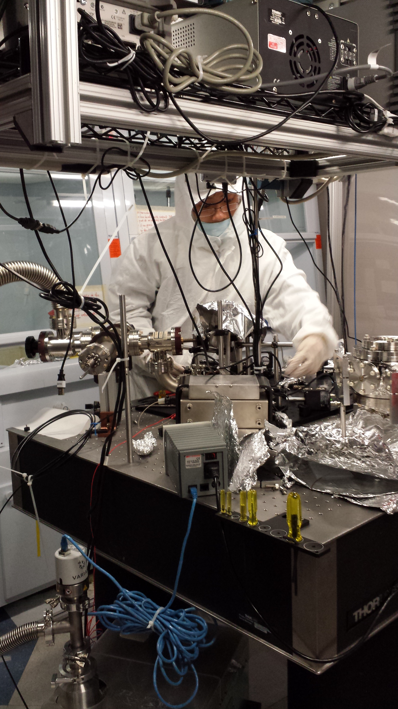

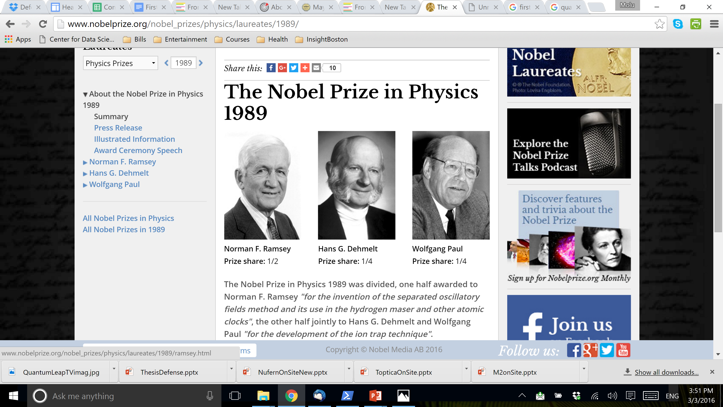
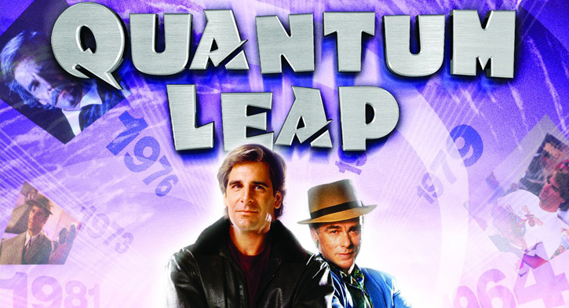

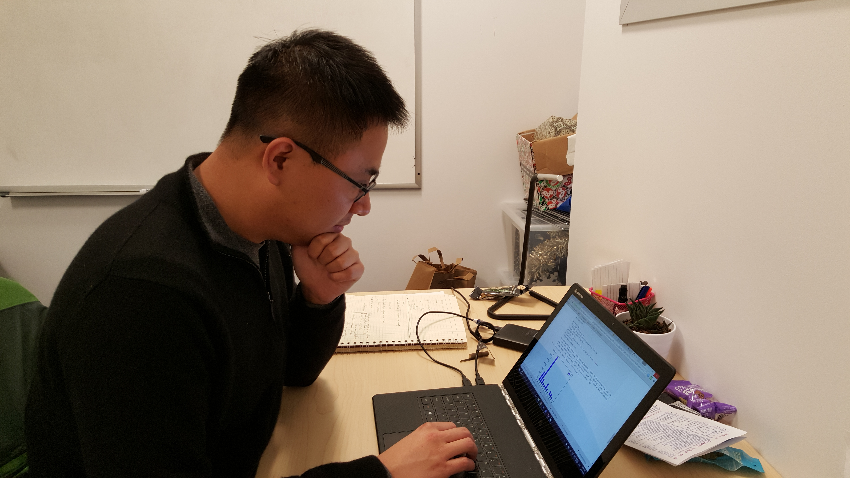
What quantum leap?
Physics: transition between two quantum states
Nobel prize in 1989
Science fiction/TV show in 1989
Me: my transition from a quantum physicist to a data scientist

Slide 3
Outline
3 weeks at Insight:
Challenges behind smartinspector.me
6 years in quantum computing:
From theory to hardware, and data

Slide 4

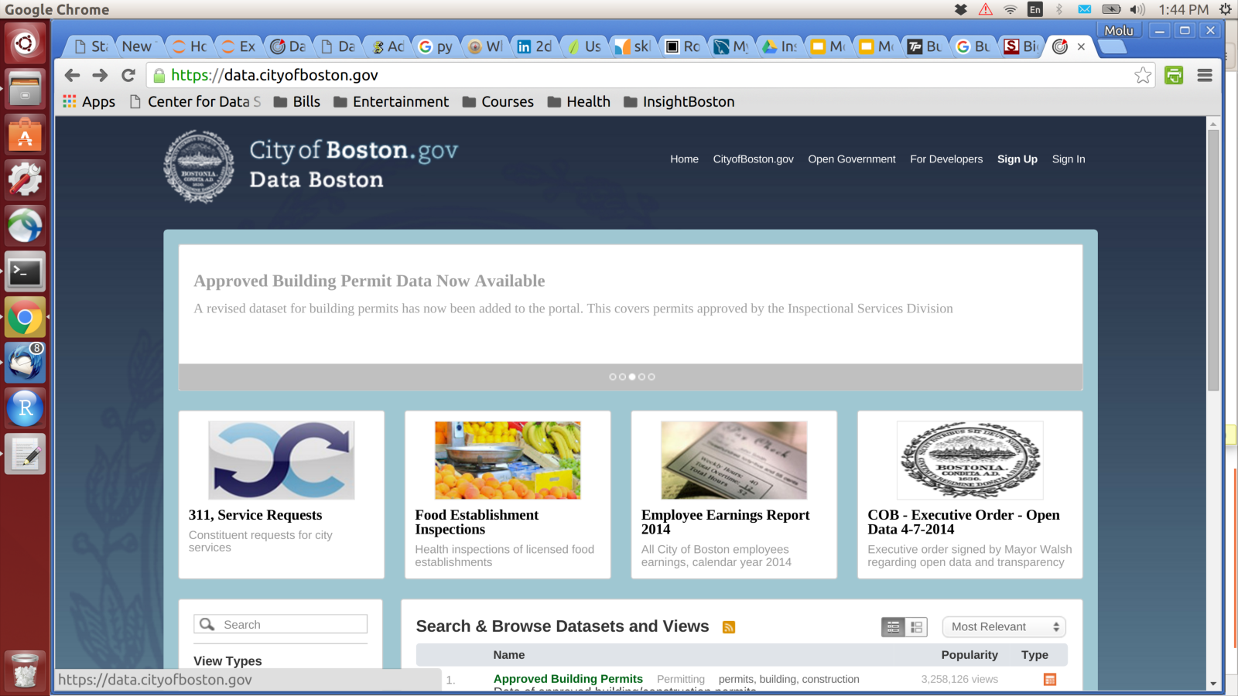
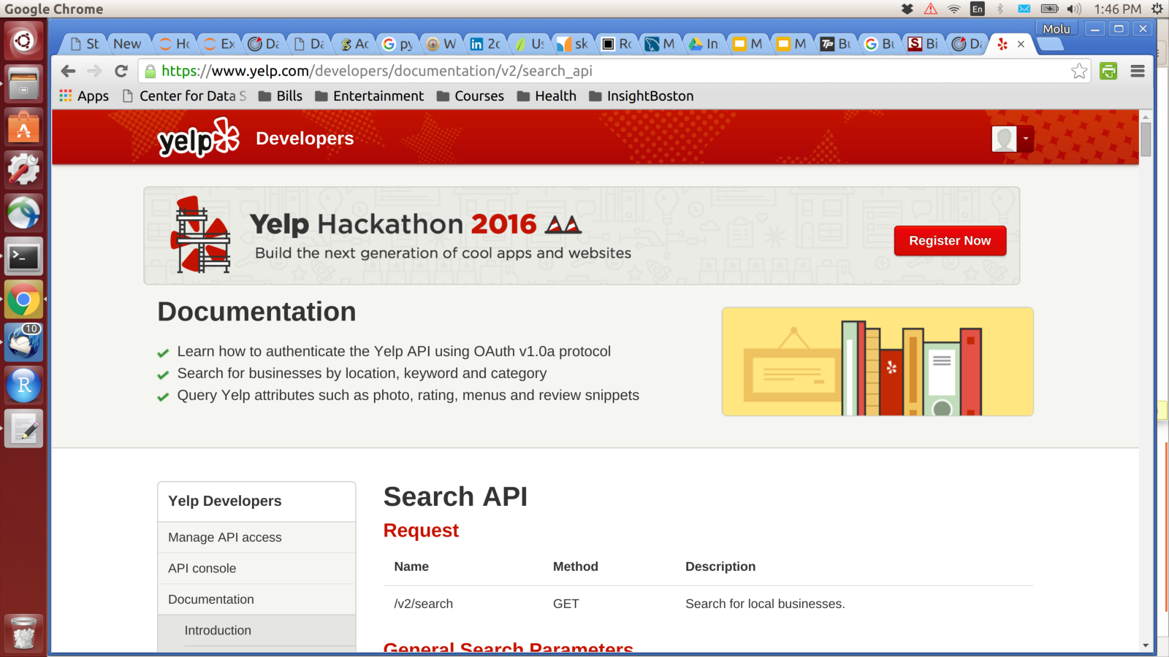
Smartinspector.me
Predict restaurant inspection:
health violation type: e.g. water quality, animal control
violation level: scale between 1 to 4
1
1
Food protection
Plumbing
Insect/Animal control
Personnel health
...
...
Water
4
4
Property value
Customer rating
Location
Business type
3
2
1

Slide 5
Path to product
Week 1
Decision on project
Week 2
Exploratory analysis
Model construction
Week 3
Visualization
Data warehouse construction
Cleaning
Validation
Scikit-learn
Website
Pandas + SQL
JavaScript + SQL
Flask +
Week 1
Week 2
Frustrated
Week 3
Finish product
Focused on plan
Simplify to-do list
Lots on to-do list
Ambitious
Solutions
Challenges

Slide 6
Challenge I: matching data

Slide 7
Challenge II: unbalanced data

Slide 8
Insights from Insight experience
Self-motivated
Fast learner
Open to challenges

Slide 9
Quantum computing
Overview of the field
Why
What
How
My experience and accomplishments

Slide 10
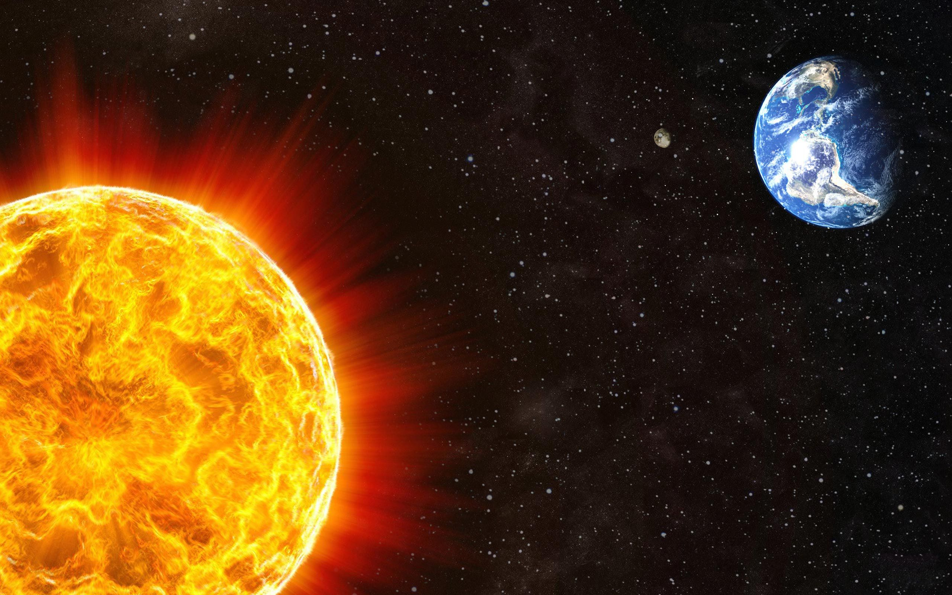
Quantum computing - motivation
Physics: describe and predict interaction using math models
E.g. Orbital motion of earth
Application: satellite launch

Slide 11


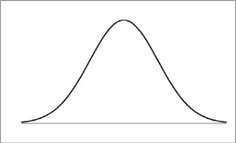
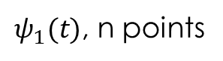
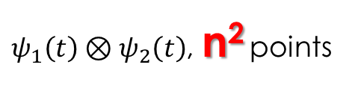
Quantum computing - motivation
Simulation at small scale: exponentially more complicated
NP problem!
Application: precisely simulate chemical reaction, protein folding, etc.
Classical
(x,p)
(x₁,p₁,x₂,p₂)
Quantum
$ψ_{1}\left(t\right)⊗ψ_{2}\left(t\right)$, n² points
$ψ_{1}(t)$, n points

Slide 12
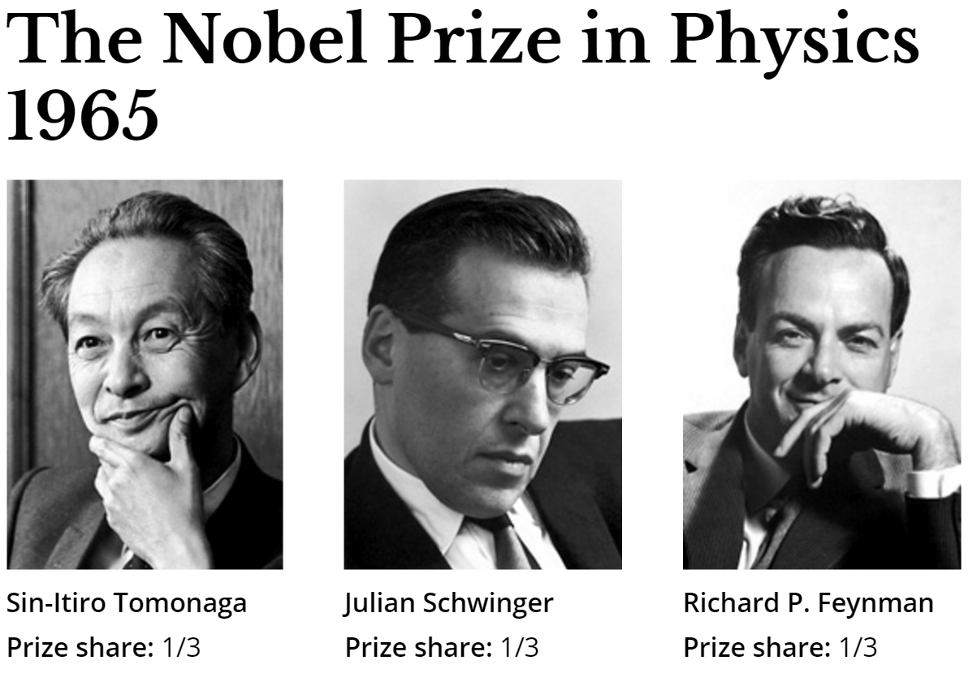
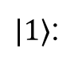
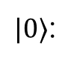
Quantum computing - Use a quantum system to simulate quantum systems
Computer: a device that computes - binary operations
Classical computer
Quantum computer
1: digital high
1: excited state
$|1〉$:
5V
Quantum operation
0V
0: gnd
0: gnd state
$|0〉$:
Bit
Quantum bit (qubit)

Slide 13

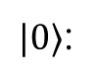
Quantum computing – algorithm gold rush
New data representation – new algorithms
NP problems in classical computing might have polynomial solution!
E.g. integer factorization
Application: cryptography = NSA’s interest = $ Funding!!!
1: excited state
$|1〉$:
Quantum operation
0: gnd state
$|0〉$:
Quantum bit (qubit)

Slide 14
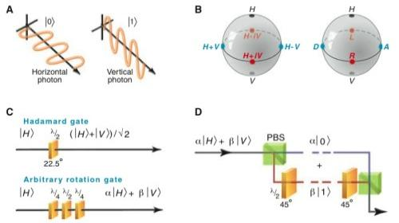
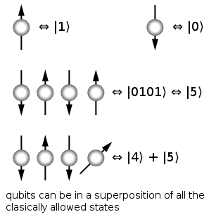
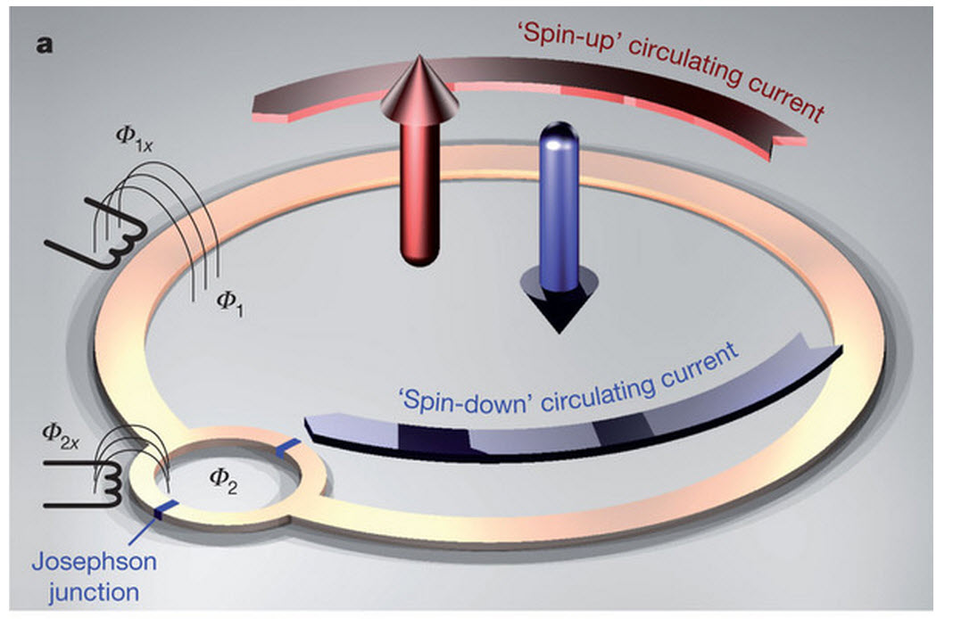
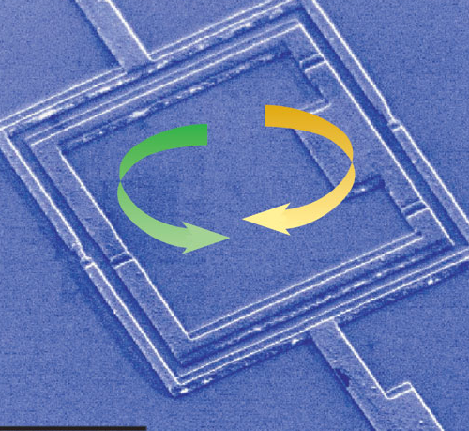
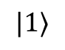

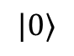

Quantum computing – how to build
1: excited state
$|1〉$:
Quantum operation
0: gnd state
$|0〉$:
Spin + NMR
Photon + wave plate
Josephson Junction
+ microwave
Atom + laser
$$|1〉$$
$$|0〉$$

Slide 15


Quantum computing – challenges
Fault tolerance – hardware accuracy vs. error correction:
Electronic computer: majority voting, no hardware limit
Message: 1
Repeat message:
1 -> 1111
Error:
1111 -> 1011
Correction:
1011 -> 1111
Received:
1111 -> 1

Slide 16
Quantum computing – challenges
Fault tolerance – hardware accuracy vs. error correction:
Electronic computer: majority voting, no hardware limit
Quantum computer: cannot clone quantum state
Gap between theory and experiment:
State-of-art error correction algorithm: 0.01% error threshold tolerance
State-of-art CNOT gate error: 1%

